Slide 1






Moviefy
Android Application
Movie base

Slide 2

01
List of all films and serials
02
Info and description of each film
Info
03
Ready free API as GoWATCH API or Utelly API
(NOT FINISHED)
04
Abilitiy to watch fims or trailers(not sure)
05
Searching films
06
List of favorites

Slide 3
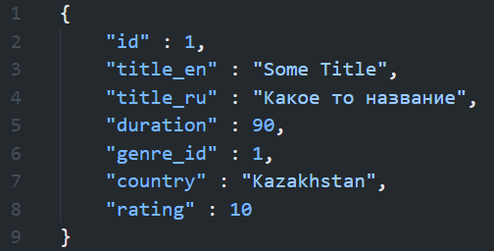
Attributes(Demo)
Simple attributes for films.

Slide 4
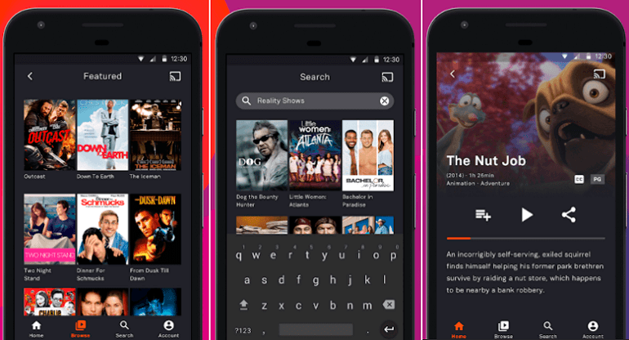
Design from "moviebase" app
Of course, App will have simpler design

Slide 5

That's it, for now.

